Slide 1

PROJECT PRESENTATION
1
KPR Institute of Engineering and Technology, Coimbatore, Tamil Nadu, India
Notes:
1

Slide 2
PROJECT PRESENTATION
Class & Team No: | IV CSE A & TEAM NO 7
Review No: | VII Semester Project (Odd Sem. Phase-I)
Title: | ALAS(ADVANCE LUMINOUS ASSISTANT SYSTEM)
Date: | 29/01/2024
Time:
KPR Institute of Engineering and Technology, Coimbatore, Tamil Nadu, India
2
Notes:
2

Slide 3
Advance Luminous Assistant System
Aravind RM – 20cs013
ArunPrakash SK – 20cs018
Dheepadarshan LB – 20cs045
Guided by:
Mr.Thivaharan S
Assistant Professor (Sr.G.) -CSE
KPR Institute of Engineering and Technology, Coimbatore, Tamil Nadu, India
3
Notes:
3

Slide 4
INDUSTRY ASSOCIATED
Industry Name - BSH Hausgeräte Engineering Company
Address details - BSH GGS Office Mind comp tech park, Whitefield, Bengaluru, Karnataka 560048
Industry supervisor :
Shwetha Shivalingapa
(Head Service Management)
KPR Institute of Engineering and Technology, Coimbatore, Tamil Nadu, India
4
Notes:
4

Slide 5
ABSTRACT
ALAS – ADVANCE LUMINOUS ASSITANT SYSTEM
ALAS focused on the autonomous functionality of the automobiles and especially on the luminous element of the vehicles.
ALAS is architecture driven, which creates an environment around the neighboring cars.
ALAS is an extension or add on to existing ADAS system
KPR Institute of Engineering and Technology, Coimbatore, Tamil Nadu, India
5
Notes:
5

Slide 6
INTRODUCTION
Problem Statement : Blindspot Caused Due To High Intensity
As we know in our day to day life driving a car is became a part of it to migrate from or to go from one place to other in this part we need to check out importance of safety , the number of accidents occurring night is much higher when compare to the day .
What we have a feature ? Which tackles the Blindspot.
KPR Institute of Engineering and Technology, Coimbatore, Tamil Nadu, India
6
Notes:
6

Slide 7
OBJECTIVE
To create an environment where the automobiles dynamically manipulate their intensity of the luminous based on their neighboring entities.
It brings the full duplex architecture between the vehicles.
Bringing a edge computing techniques to faster transformation of data between the entities.
KPR Institute of Engineering and Technology, Coimbatore, Tamil Nadu, India
7
Notes:
7

Slide 8
LITERATURE SURVEY
AUTHOR | TITLE AND YEAR | METHODOLOGY | ADVANTAGES | DISADVANTAGES
Yakusheva Nadezda1 , Gian Luca Foresti2 and Christian Micheloni2 | An ADAS Design based on IoT V2X Communications to Improve Safety | Using Vehicle-to-everything technology refers to the sensors, cameras and wireless connectivity that allow vehicles to share real-time information with their drivers, other vehicles, pedestrians and roadway infrastructure like traffic lights. | Seamless communication with neighboring cars and IoT equipment's. | General overview on communication technology and not focused on individual component.
Jaswanth Nidamanuri , Chinmayi Nibhanupudi, Rolf Assfalg, and Hrishikesh Venkataraman | A Progressive Review: Emerging Technologies for ADAS Driven Solutions | This paper identifies the research gaps, reviews the state-of-the-art looking at the different functionalities of ADAS and its levels of autonomy. | Implementation of ADAS for less disciplined roads. | More focused on machine learning components rather than on road implementation.
*
KPR Institute of Engineering and Technology, Coimbatore, Tamil Nadu, India
8
Notes:
8

Slide 9

EXISTING SYSTEM
It is the system where it is only available for BMW cars and its specially applicable in United kingdom(UK) manufactured BMW not in India and it is assigned in the cars of higher range not for low or middle budget cars
In BMW With the High Beam Assistant, when a front facing camera integrated into your BMW near the rearview mirror detects the headlights of oncoming vehicles from a distance of 700 meters, the system turns your low beams on automatically.
As you can observe that it works in a single manner not in dual beneficial manner.
KPR Institute of Engineering and Technology, Coimbatore, Tamil Nadu, India
9
Notes:
9

Slide 10
PROPOSED SYSTEM
3 Phase architecture :
1. Communication Establishment Phase
2. Beam Control Phase
3. Regain Phase.
User-Friendly UI – Dashboard for infotainment system along also supports in app
Sensor alignments based on their crui
KPR Institute of Engineering and Technology, Coimbatore, Tamil Nadu, India
10
Notes:
10

Slide 11
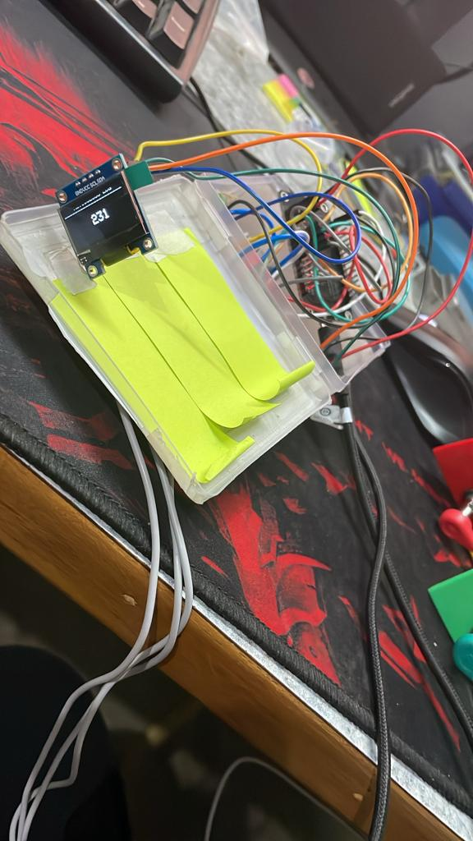
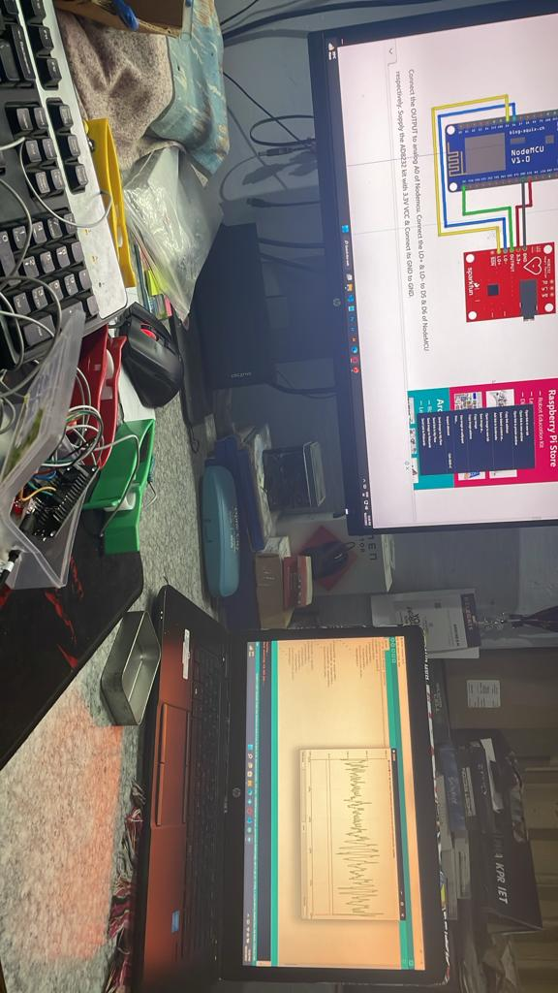
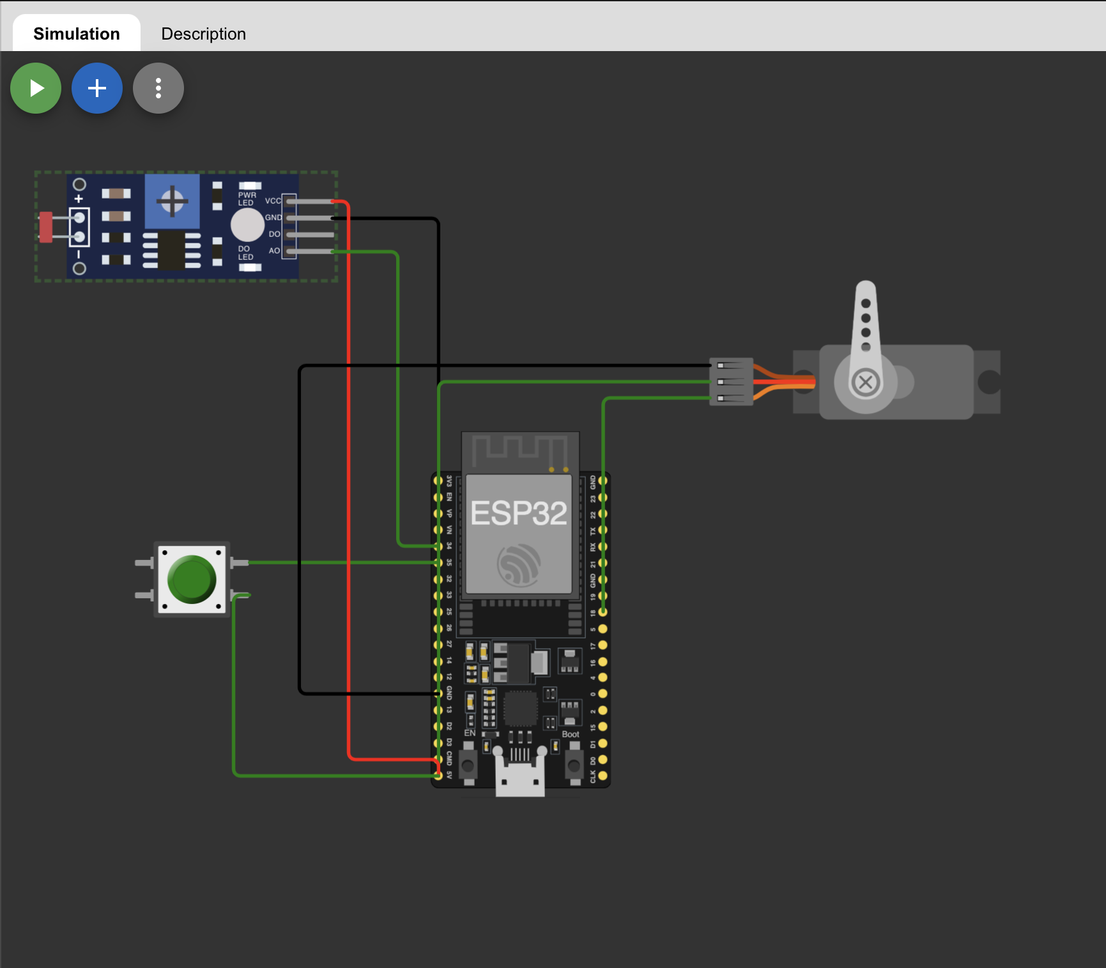
EXPERIMENTAL SETUP
KPR Institute of Engineering and Technology, Coimbatore, Tamil Nadu, India
11
Notes:
11

Slide 12




IMPLEMENTATION DETAIL
UI
MIDDLE-WARE
IOT
KPR Institute of Engineering and Technology, Coimbatore, Tamil Nadu, India
12
Notes:
12

Slide 13
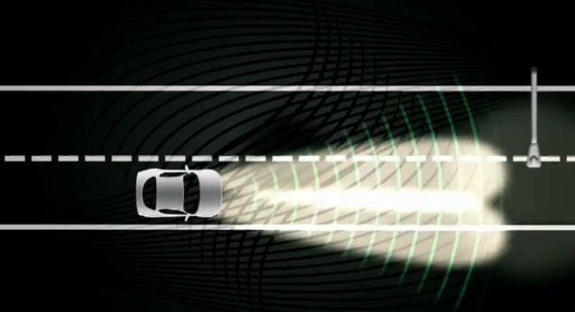
Expected Results
Vehicle running with high intensity
Vehicle detects another light object and establishes the connection
KPR Institute of Engineering and Technology, Coimbatore, Tamil Nadu, India
13
Notes:
13

Slide 14
Expected Results
Beam automatically
It goes into the beam control phase and reduces the intensity
KPR Institute of Engineering and Technology, Coimbatore, Tamil Nadu, India
14
Notes:
14

Slide 15

CONCLUSION
ALAS helps a lot to reduce the road accidents.
ALAS can bring a great change in the transport system as it helps a lot to drive the vehicles in a safe manner and also helps in the night time.
Almost all vehicle accidents are caused by human error, which can be avoided with Advance Luminous Assistant System(ALAS).
The role of ALAS is to prevent deaths and injuries by reducing the number of car accidents and the serious impact of those that cannot be avoided.
KPR Institute of Engineering and Technology, Coimbatore, Tamil Nadu, India
15
Notes:
15

Slide 16
REFERENCES
[1] Headlamp - Wikipedia, the free encyclopedia
http://en.wikipedia.org/wiki/Headlamp
[2] HIGH Beam ASSIST
http://www.audizine.com/forum/showthread.php/487621-HIGHBeam- ASSIST
[3] AUTOMATIC HEADLIGHT INTENSITY
CONTROLLER http://zonascience.blogspot.com/2009/08/automatic-headlightintensity.html
[4] High Beam Control: making driving safer and more convenient
http://www.mazda.ie/videos/technology/high-beam-control-makingdrivingsafer-and-more-convenient/
KPR Institute of Engineering and Technology, Coimbatore, Tamil Nadu, India
16
Notes:
16

Slide 17
Thank you.
*
KPR Institute of Engineering and Technology, Coimbatore, Tamil Nadu, India
17
Notes:
17

